Slide 1
Efficient / long-range Transformers
FMNLP, Fall 1401
Yadollah Yaghoobzadeh
University of Tehran
Slides adapted from

Slide 2
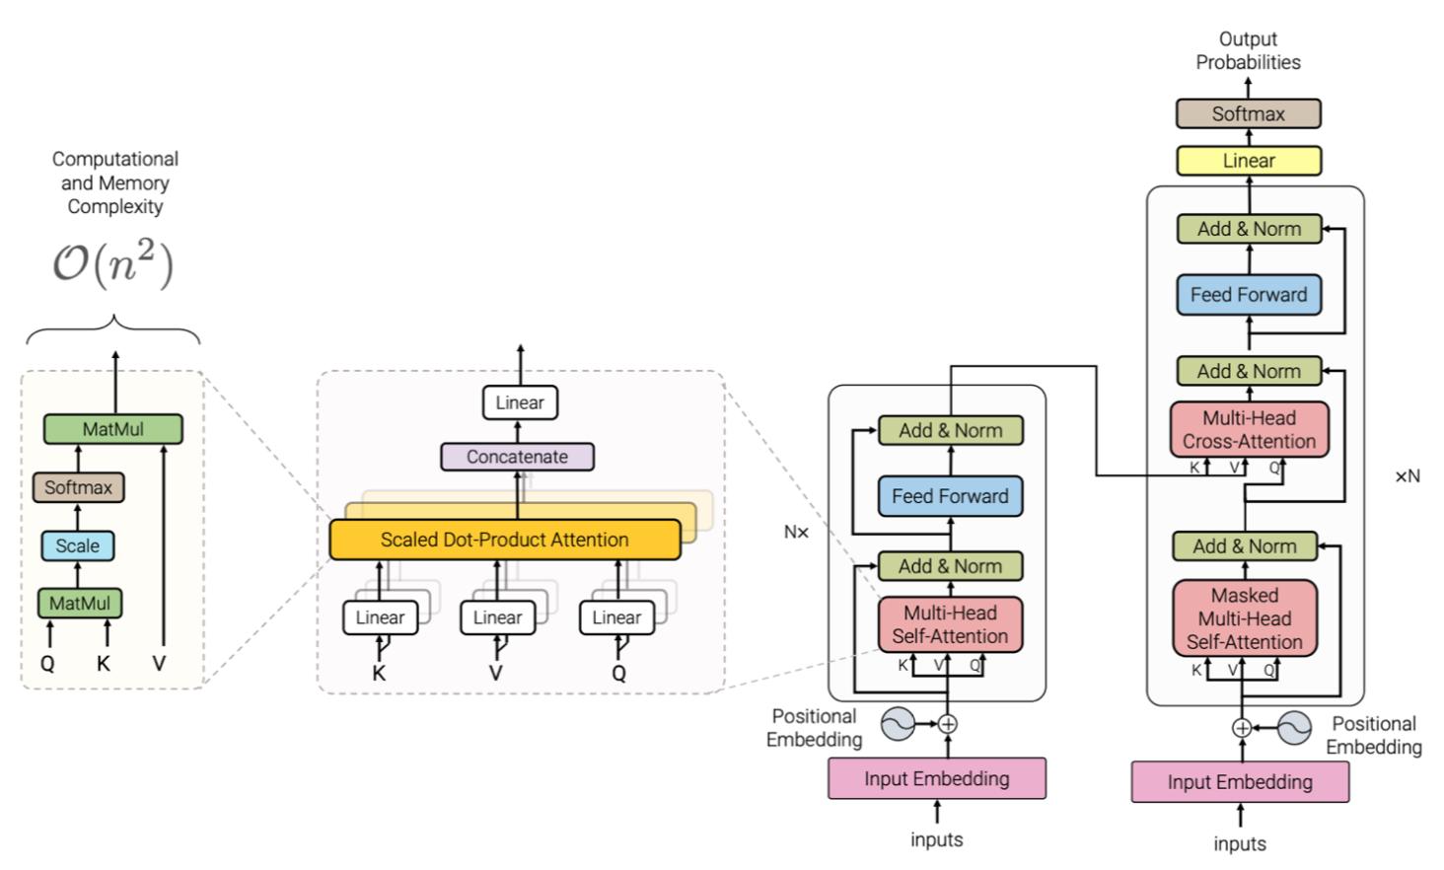
Quadratic complexity of self-attention

Slide 3
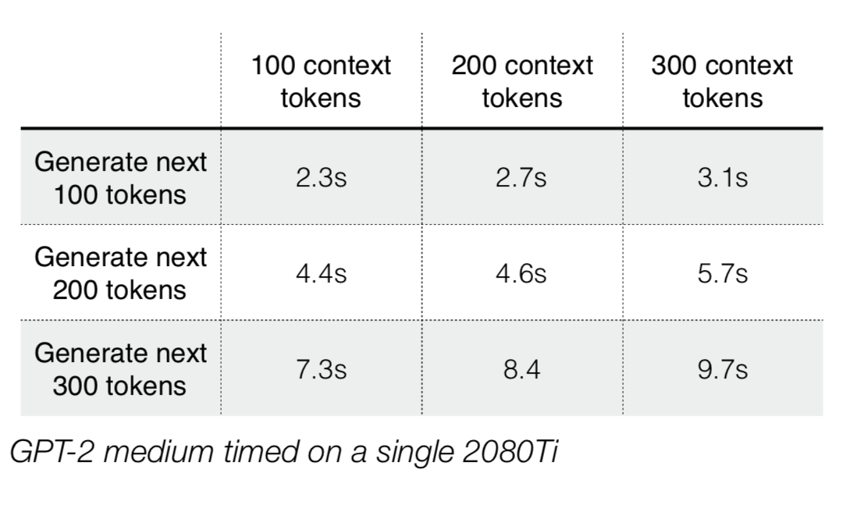
Transformer LMs are slow

Slide 4
Designing more efficient self-attention

Slide 5
Self-attention

Slide 6
Self-attention

Slide 7
Self-attention

Slide 8
Self-attention

Slide 9
Self-attention

Slide 10
what if instead of learning the attention scores, we simply hard-code them?

Slide 11
Hard-coded self-attention

Slide 12
Hard-coded self-attention

Slide 13
Hard-coded self-attention

Slide 14
Hard-coded self-attention

Slide 16
how much do you need self-attention?

Slide 17
how much do you need self-attention?

Slide 18
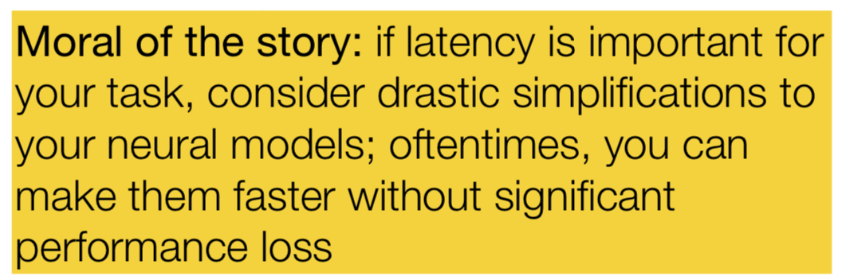
Efficiency improvements
Batch-size increase: hard-coding self-attention and reducing cross attention heads allows us to use 27% more tokens per batch
Decoding speed (sentences/sec) increase by 30.2% over the baseline Transformer

Slide 19

Local Attention
Position-based sparse attention
Each token only attends to previous K tokens
Pic screenshot from: https://arxiv.org/pdf/2003.05997.pdf

Slide 20
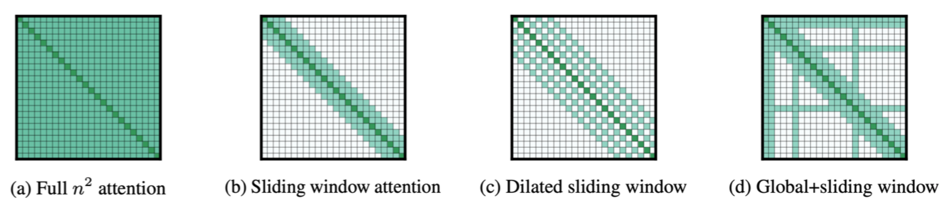
Longformer
Try other types of fixed attention patterns

Slide 21
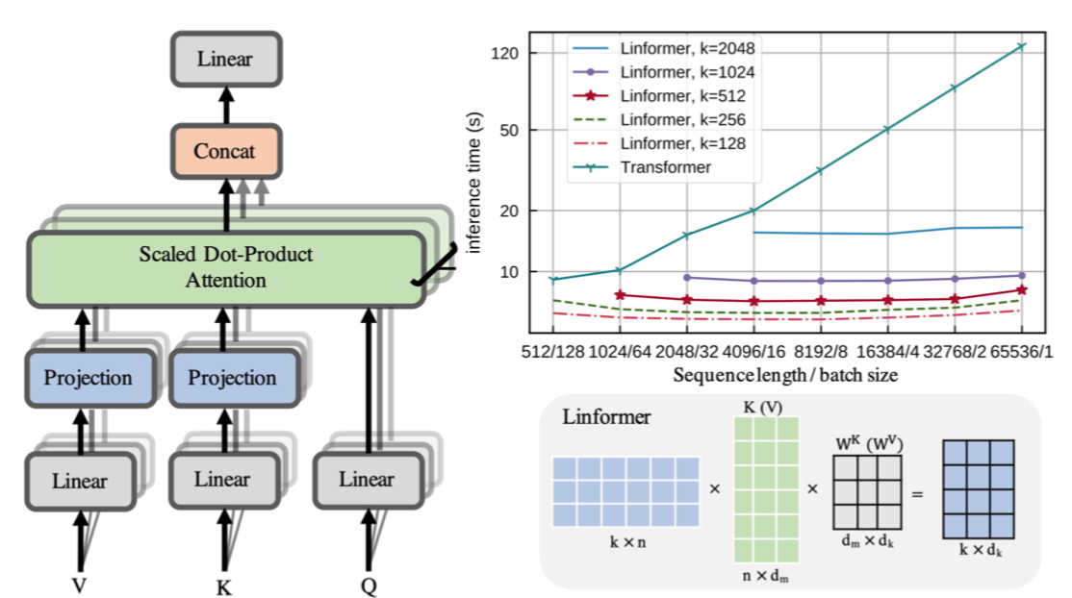
Linformer
Main idea: produce a low-rank approximation of the attention matrix

Slide 22
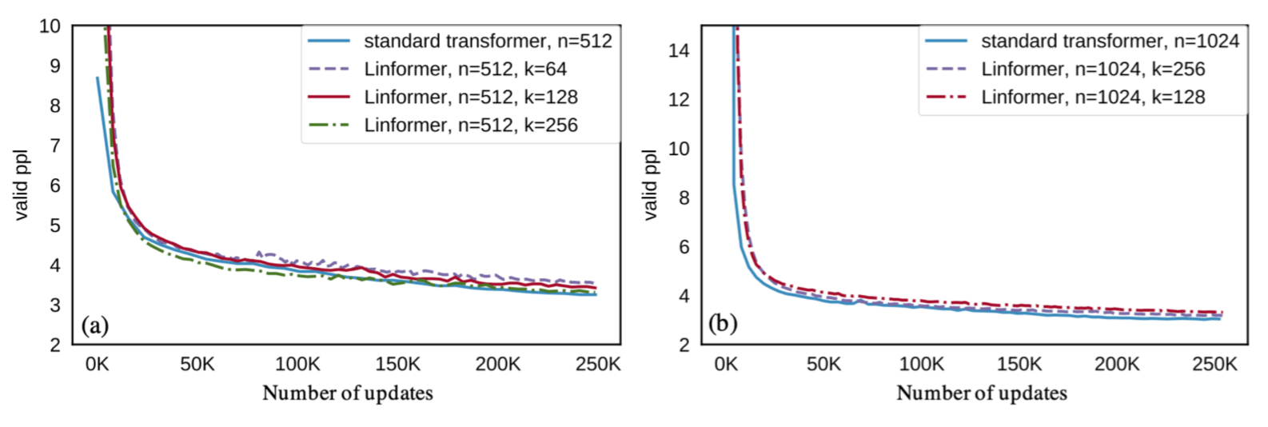
Linformer results

Slide 23
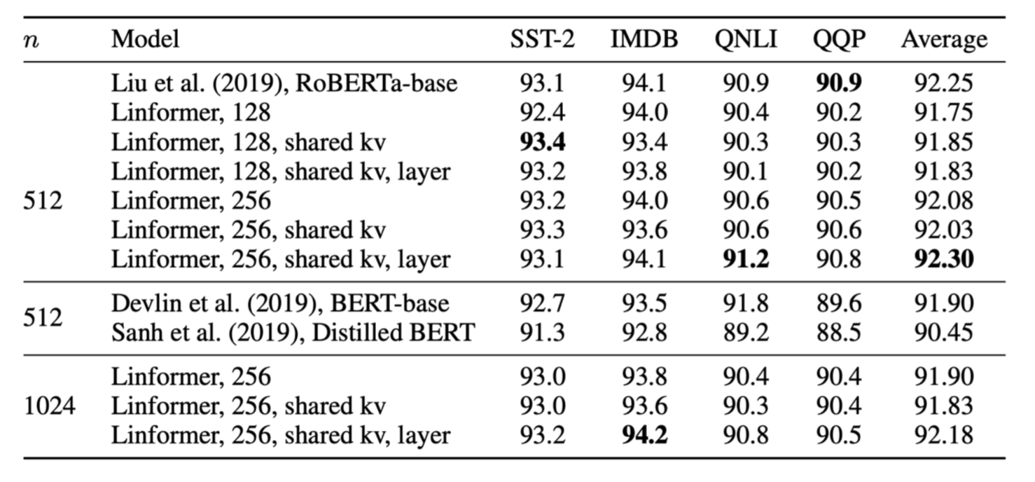
Also effective in BERT-like models

Slide 24
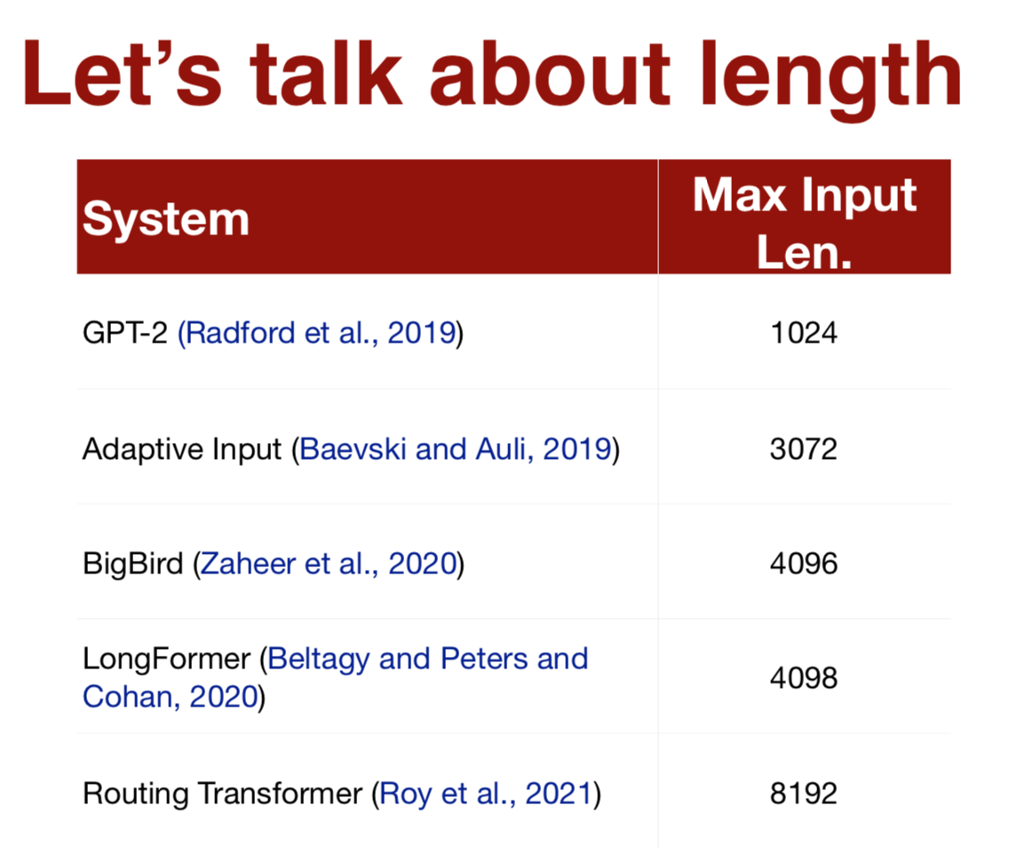

Slide 25

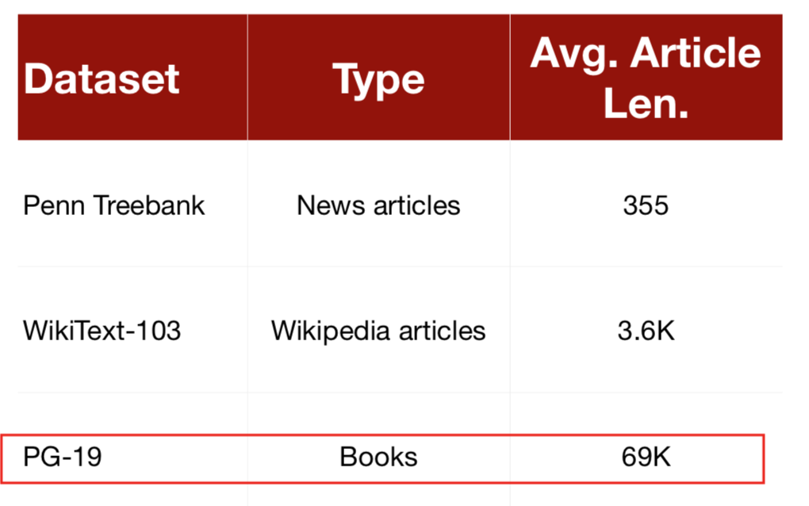

Slide 26
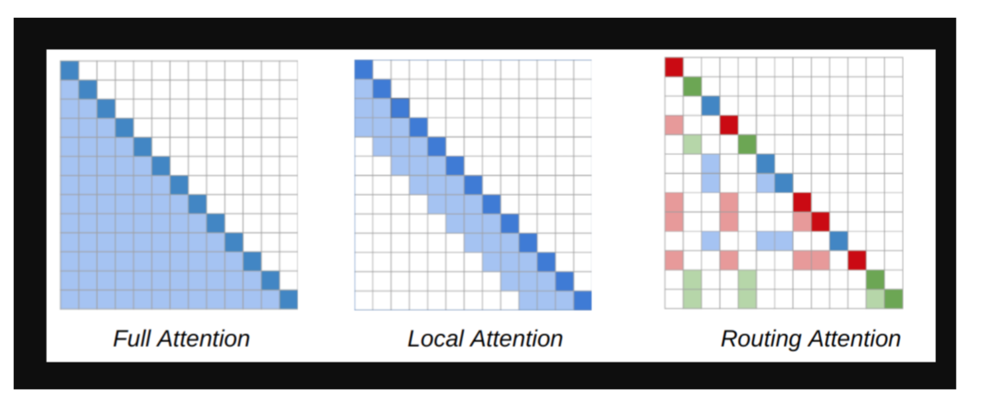
What about content-based sparsity?

Slide 27
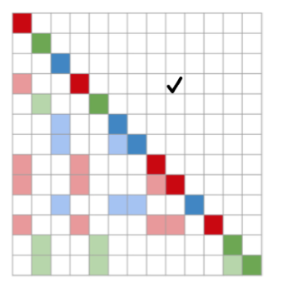
Routing Transformer (RT)
Content-based sparse attention
Tokens are assigned to different clusters Attention is performed only within each cluster
Pic screenshot from: https://arxiv.org/pdf/2003.05997.pdf

Slide 28
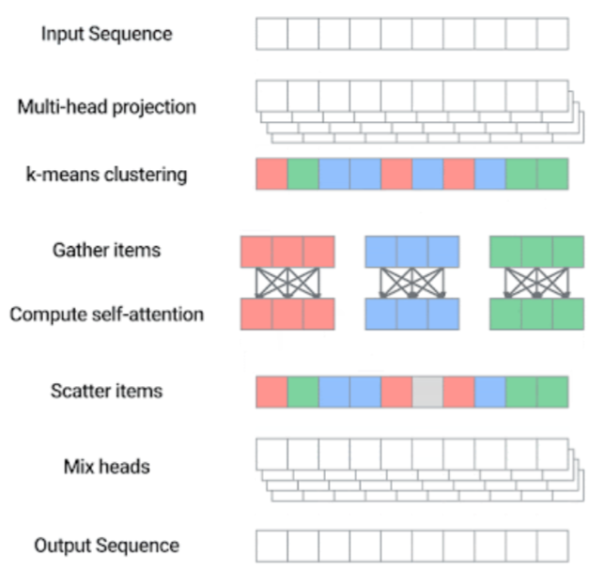
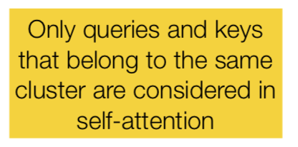

Slide 29
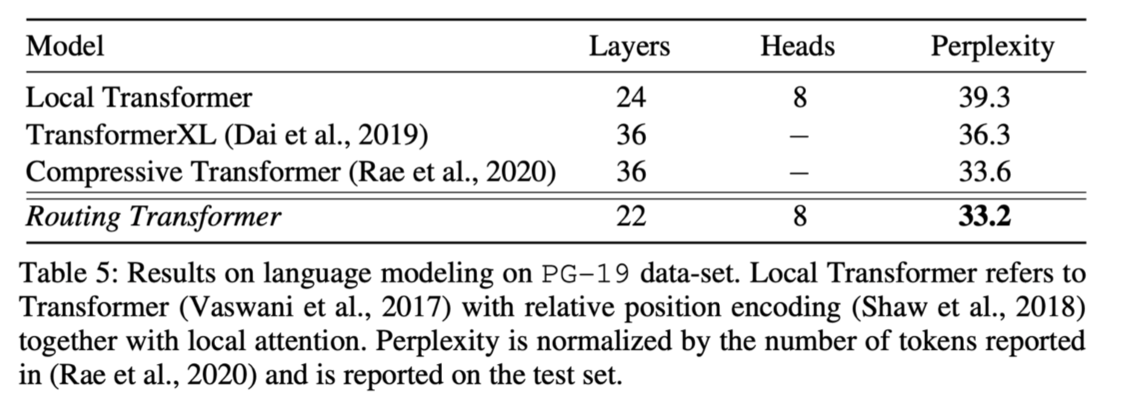

Slide 30
What do these models do with these longer contexts?

Slide 31
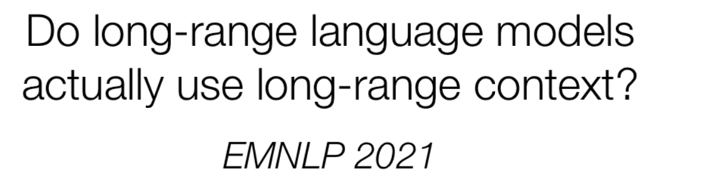

Slide 32
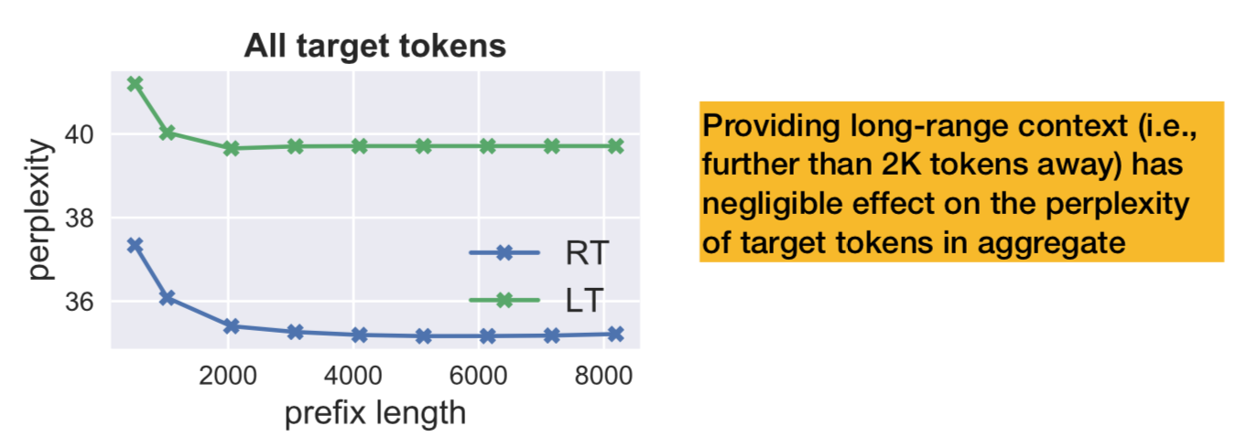
The effect of longer context
Target tokens sampled from PG-19 validation set
Compute perplexity of target tokens preceded by prefix of various lengths

Slide 33
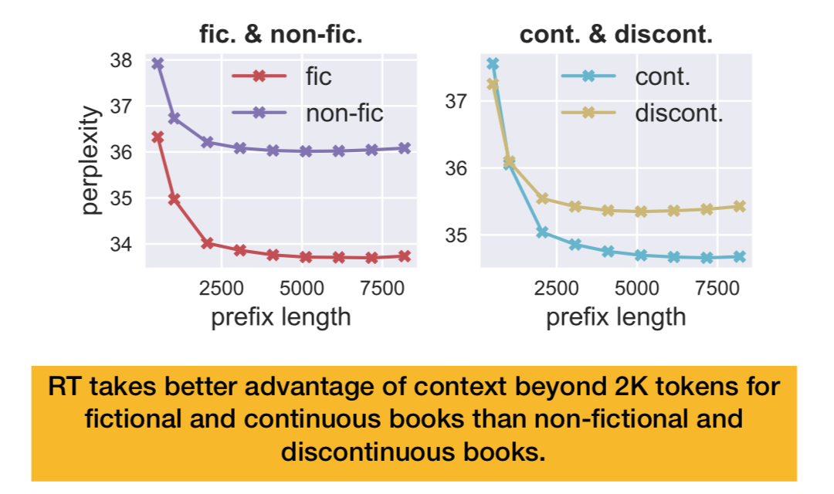
The effect of longer context
Fictional vs. non-fictional
Continuous vs. discontinuous

Slide 34
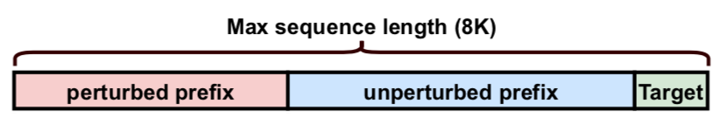
The perturbation of longer context
Fixed context size, perturb distant context
Types of perturbation
Shuffling
Random replacement
Specific token dropout

Slide 35
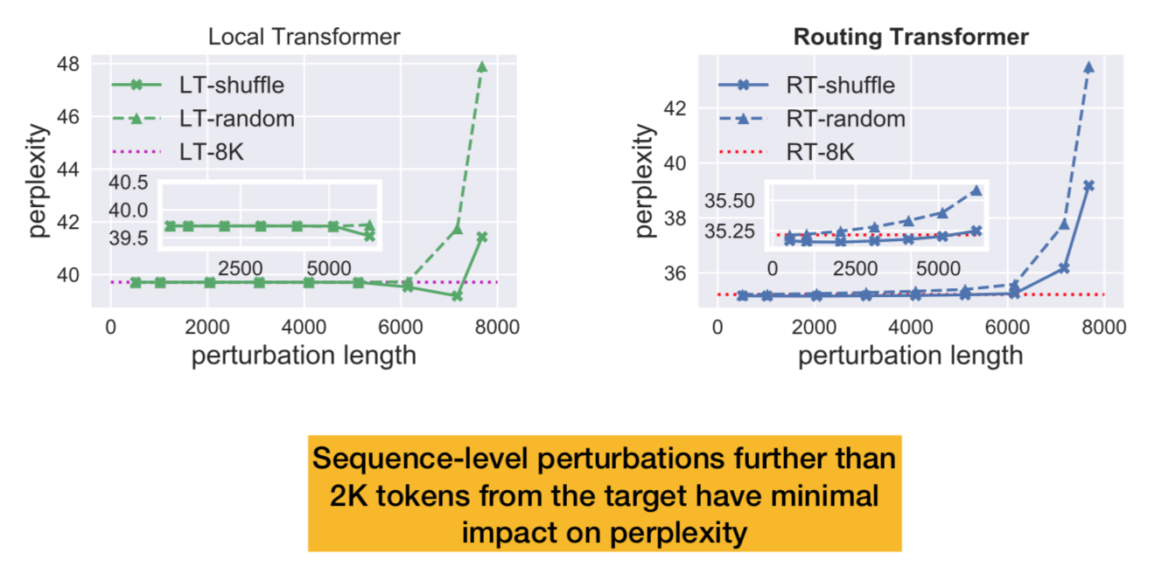
The perturbation of longer context
Evaluate over all target tokens

Slide 36
While these LMs can computationally handle long contexts, they have a long way to go before they can take advantage of the information within these contexts!

